Slide 1
VOCAL FOR LOCAL
Farmer friendly software project
Date :28th December 2020

Slide 2
AGENDA/ TOPIC
INTRODUCTION
EXISTING PROJECT
PROPOSED SYSTEM
WORK DONE SO FAR
WORK TO BE DONE

Slide 3
INTRODUCTION
As name says that local vendors/farmers will become self dependent
Equal share of the profit for the farmers
Agriculturists will become more in number.
This project is Farmer Friendly.

Slide 4
INTRODUCTION(..continued)
We would look forward to the local solution in light of global experience, particularly with an Indian perspective.
Primary objective of our project is to promote farmers and local vendors and it would also contribute in making our country self sufficient.

Slide 5
INTRODUCTION (..continued)

Slide 6
EXISTING SYSTEM
Agriculture Database Management System India Guwahati developed by Eastern India Technosoft PVT.LTD.
The objective of this project include various types of govt. individual to manage huge amount of data with various types of credential
1. Area Statistics
2. Production Statistics
3.Land Use Statistics
Benefits of the farmers in Agriculture DBMS are guidance on crop planning, form mechanism, providing on-time soil testing.

Slide 7
EXISTING SYSTEM (..continued)
There are many softwares that helps in agriculture like weather forecast , pesticides are used to crop improvements and economic value on products.
Softwares are AGRIVI, GRANULAR etc.

Slide 8

PROPOSED SYSTEM
Helps more to farmers and Local vendors
Problems which are faced by farmers in existing system will be solved in our system
And now we are making this system for only one district
By supporting the local farmers today, we are helping to ensure that there will be farms in our community.

Slide 9

WORK DONE SO FAR
The backend part of our project is completed.
80% frontend is completed

Slide 10
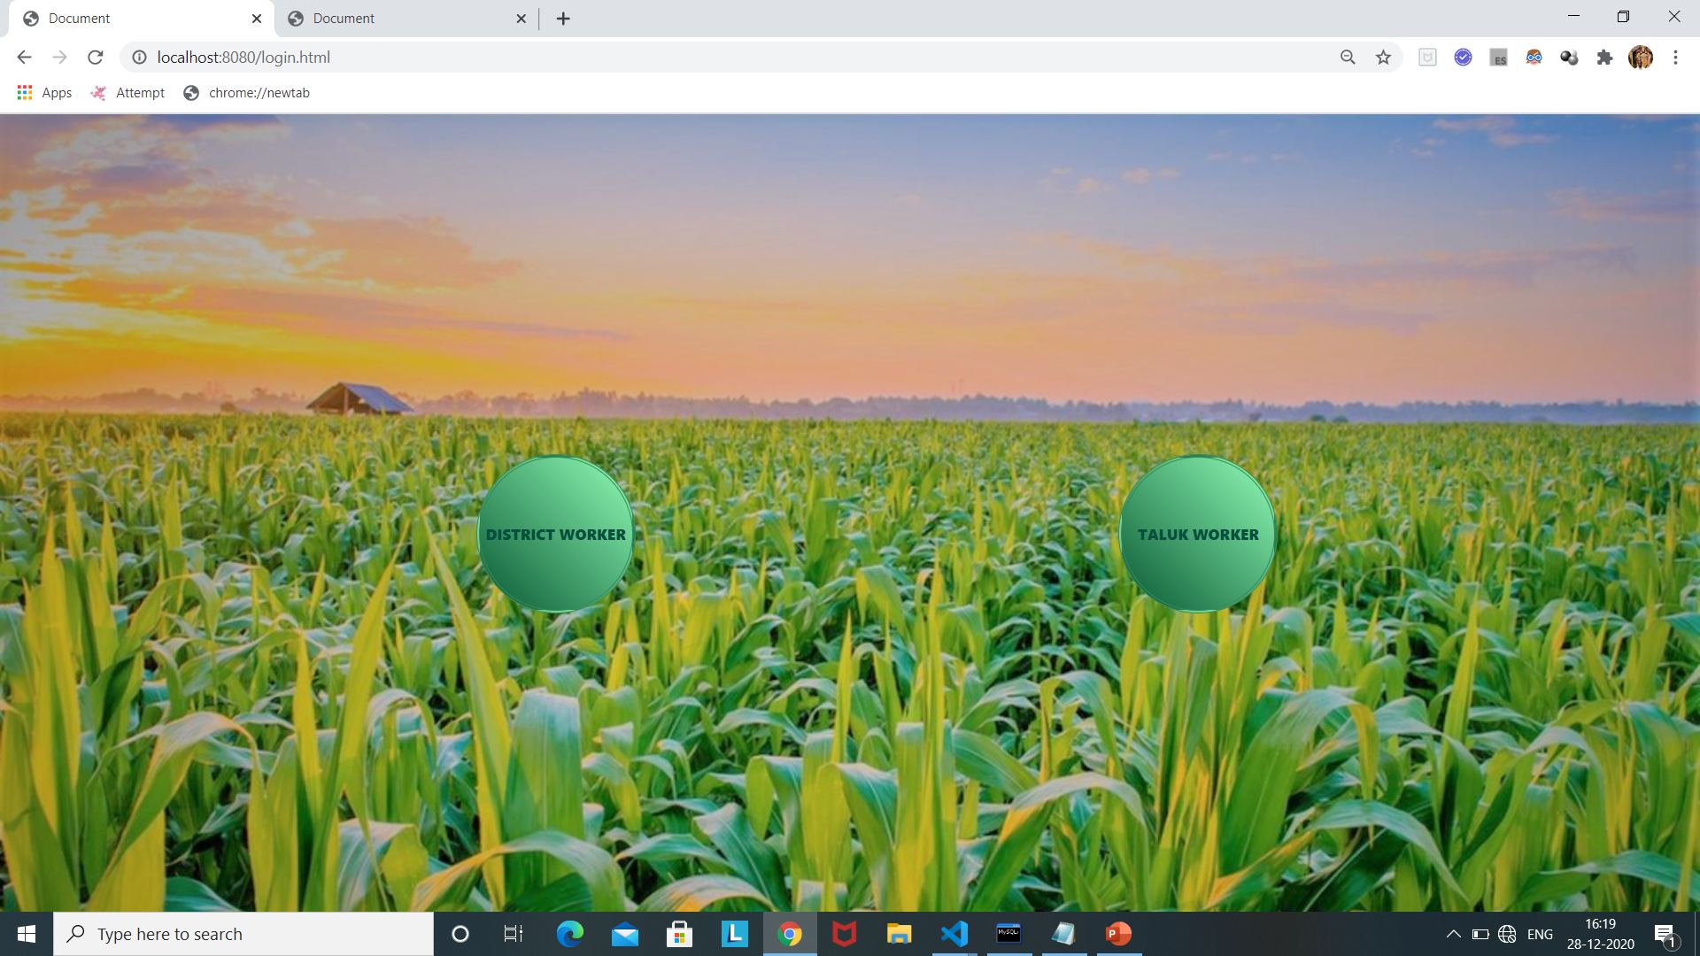
HOME PAGE
Basically contains two buttons:
The district button navigate to the District login window and The Taluk button navigate to the Taluk login window

Slide 11
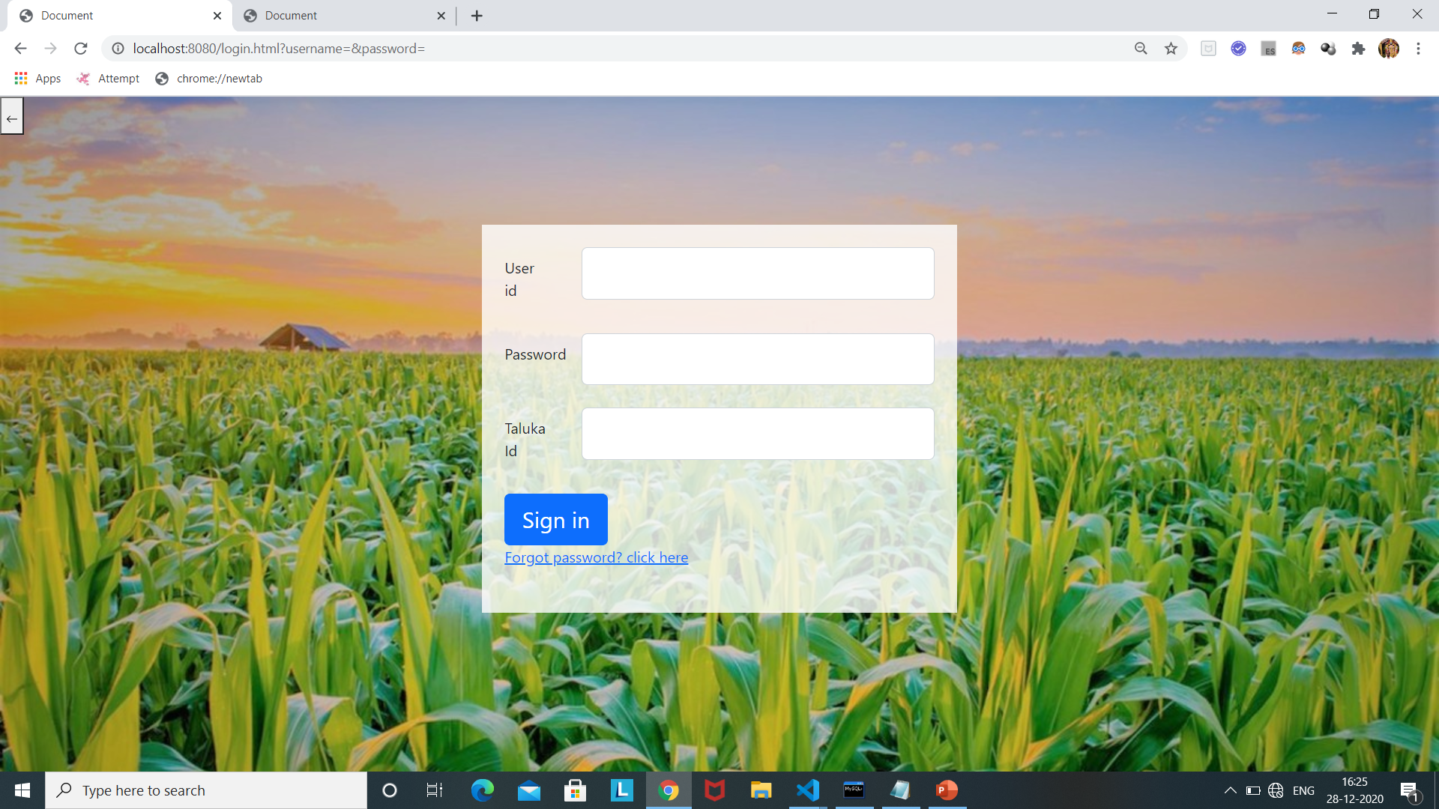
TALUK LOGIN WINDOW:
The taluk login window contains mainly contains three fields i.e. user id , password and taluk id.
And it also contain extra link Forgot password to change password.

Slide 12
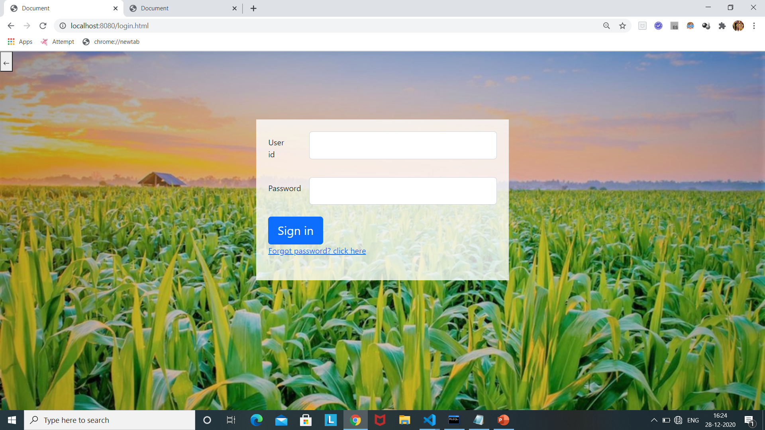
DISTRICT LOGIN WINDOW
The district login window contains mainly two fields i.e. userid and password
And it also content Forgot password link to change password.

Slide 13
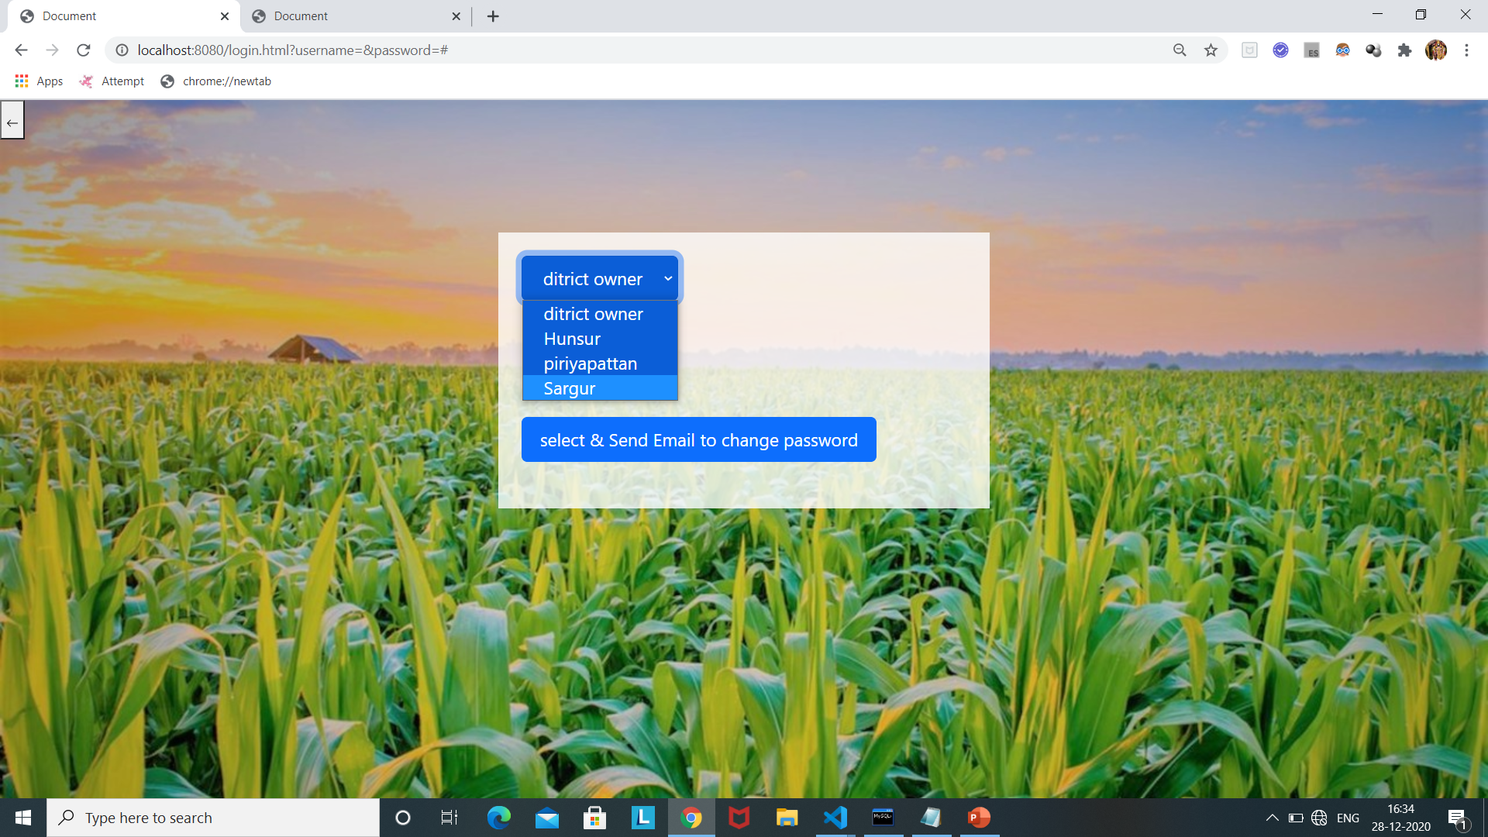
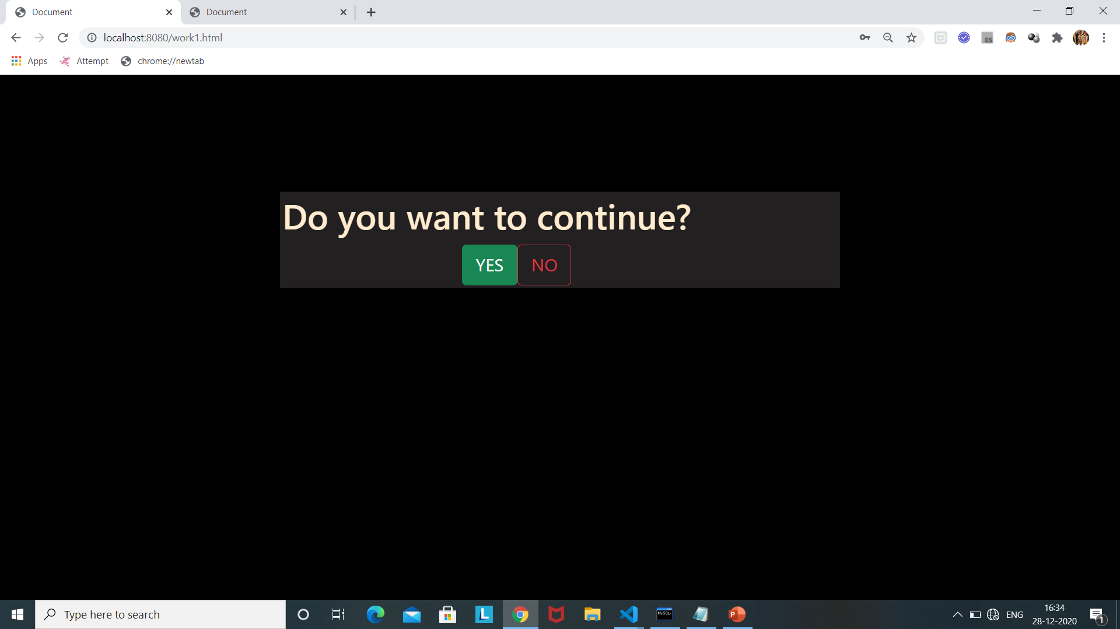
Continued…
Forgot password
Confirmation to open respective page

Slide 14
Continued…
When we click on sign in button if authenticated successfully then respected Taluk/District page will open by asking the confirmation with user.
if it is not authenticated successfully then again display the same login page.

Slide 15
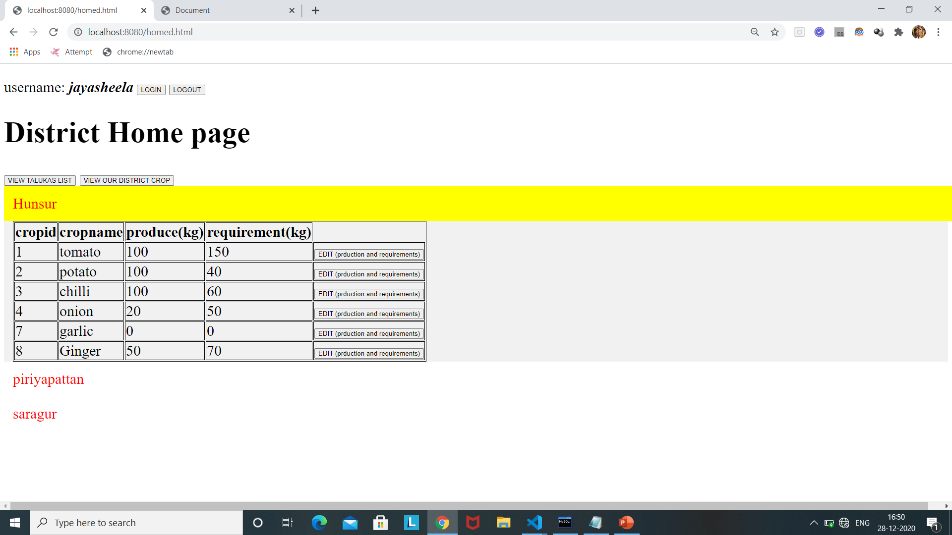
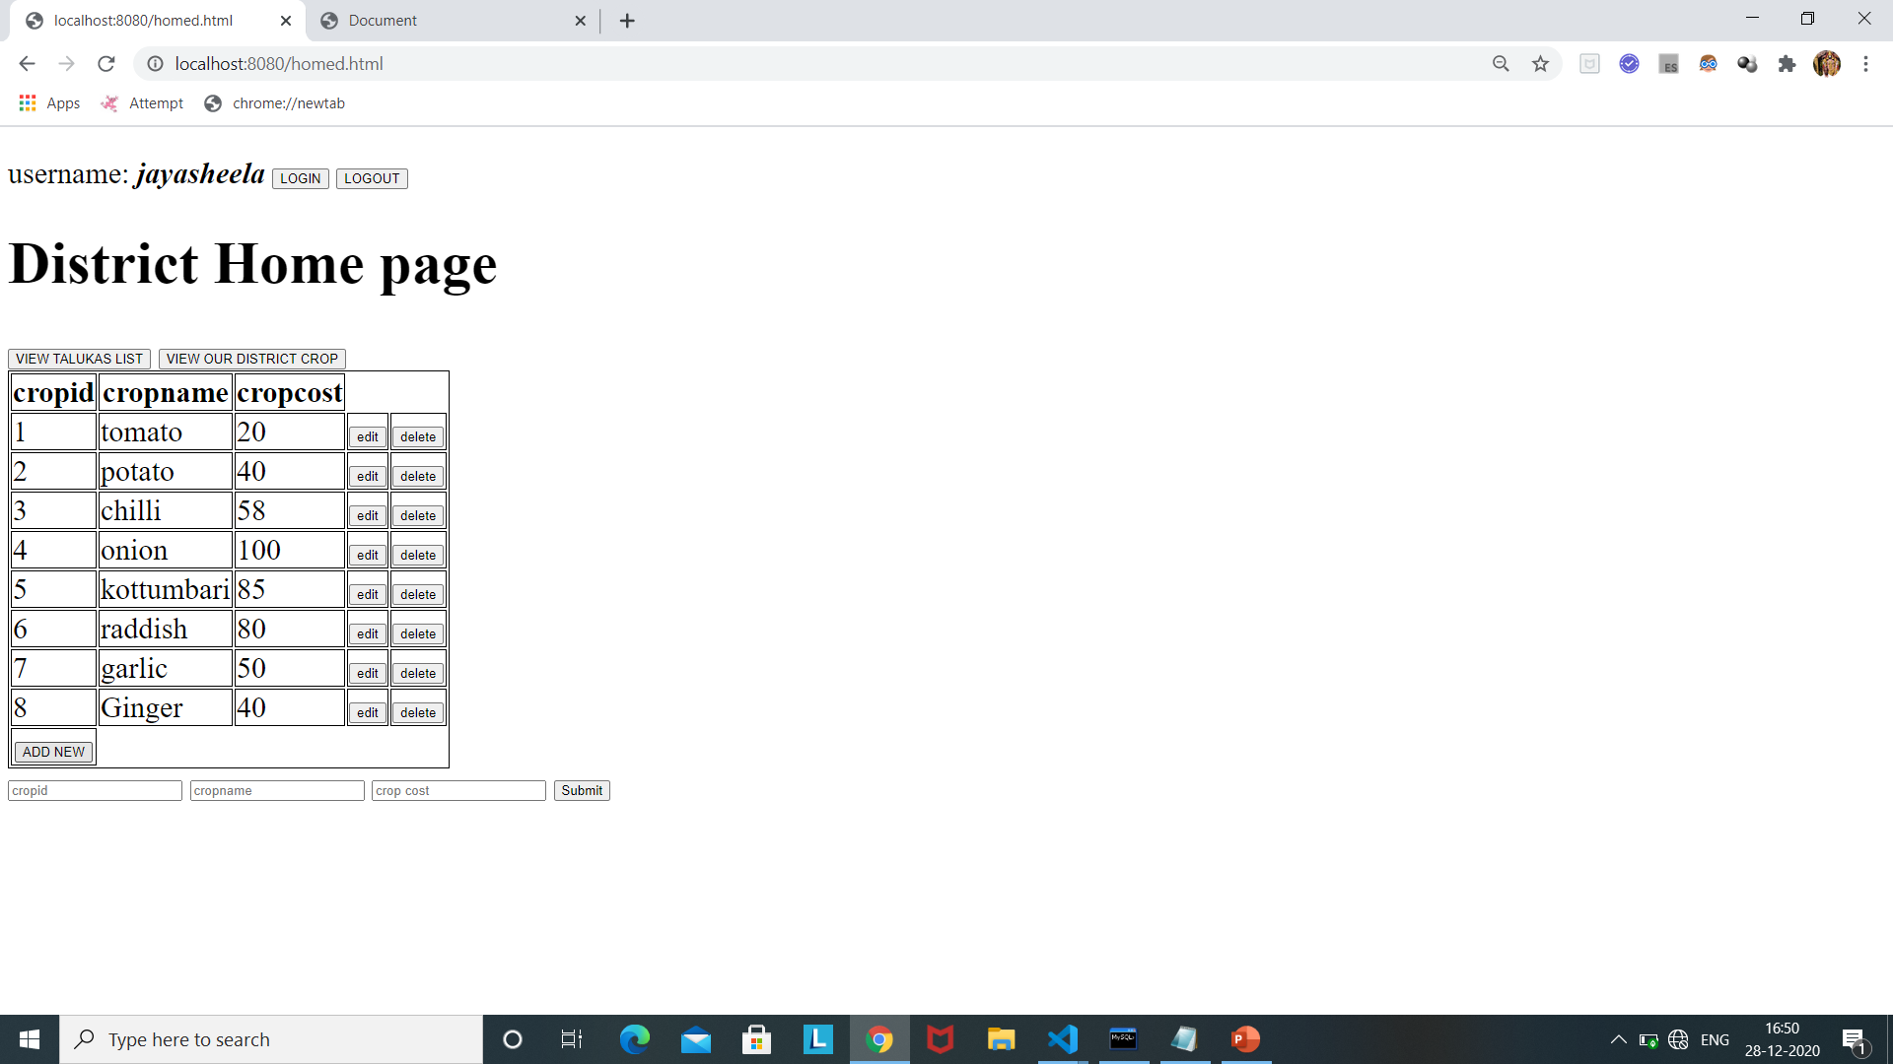
DISTRICT HOME PAGE

Slide 16
Continued….
The district home page contains a navigation bar that contains district name and username and also a button to logout from the present page.
Below the navigation bar it has two buttons The first gives us the taluka list and their production and requirements.
The second button gives us the crops list and their respective cost.
Every entry of the taluka list has a button to edit production and requirements
and every entry in crops list has two buttons i.e. edit and delete
In EDIT we can edit the cropname and cropcost
The delete button can be use to delete the crops i.e. not used by any talukas under this district.
And another one button in district crop list page to add new crop with crop cost.

Slide 17
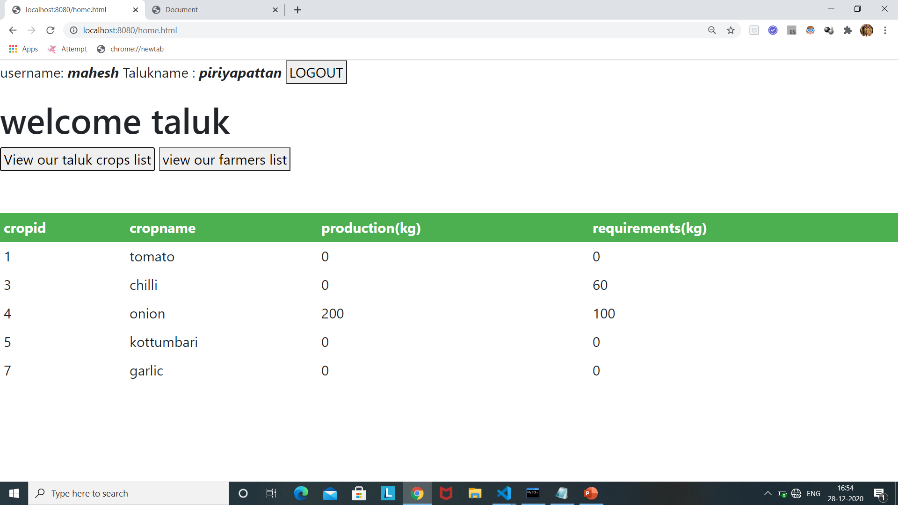
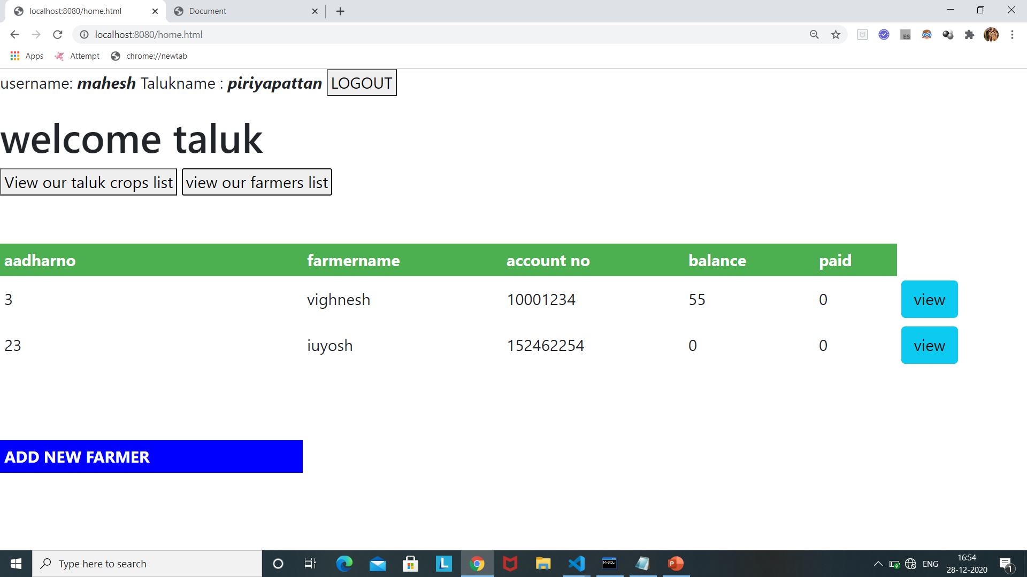
TALUK HOME PAGE

Slide 18
Taluk Home Page:
The taluk home page contains a navigation bar that contains Taluk name and username and also a button to logout from the present page.
Below the navigation bar, it has two buttons like
view our crops list
view our farmers list
when we click on 1st button it display all crops we using in that taluk and their crop cost also show but can't edit.
when we click on 2nd button view our farmers list, five fields table will be display are
aadharno,farmername,accountno,balance & paid.
Every entry of the farmers list contain one button to go to the specific/personal page of his farmer.
And one button below all i.e. ADD new farmer, when we click on that it ask to fill aadhar number, name and account number.
when we click on view button the respected farmer detail will display.

Slide 19
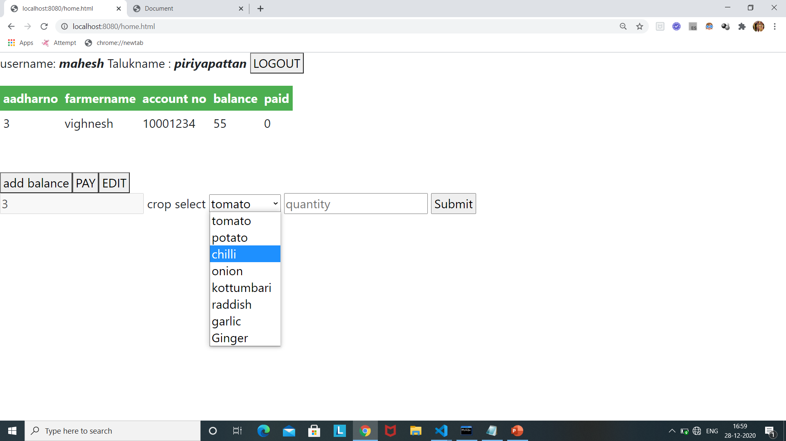
Continued….
when we click on view button the respected farmer detail will display.
Once open that it display five fields like Aadharnumer,Farmername,Accountnumber, Balance and Paid.
Below two buttons for the respected farmer only has Addbalance, Pay and Edit.
when we click on Add balance it show like →
Select crop and add quantity it add balance to his balance field by multiplying crop codt with quantity.

Slide 20
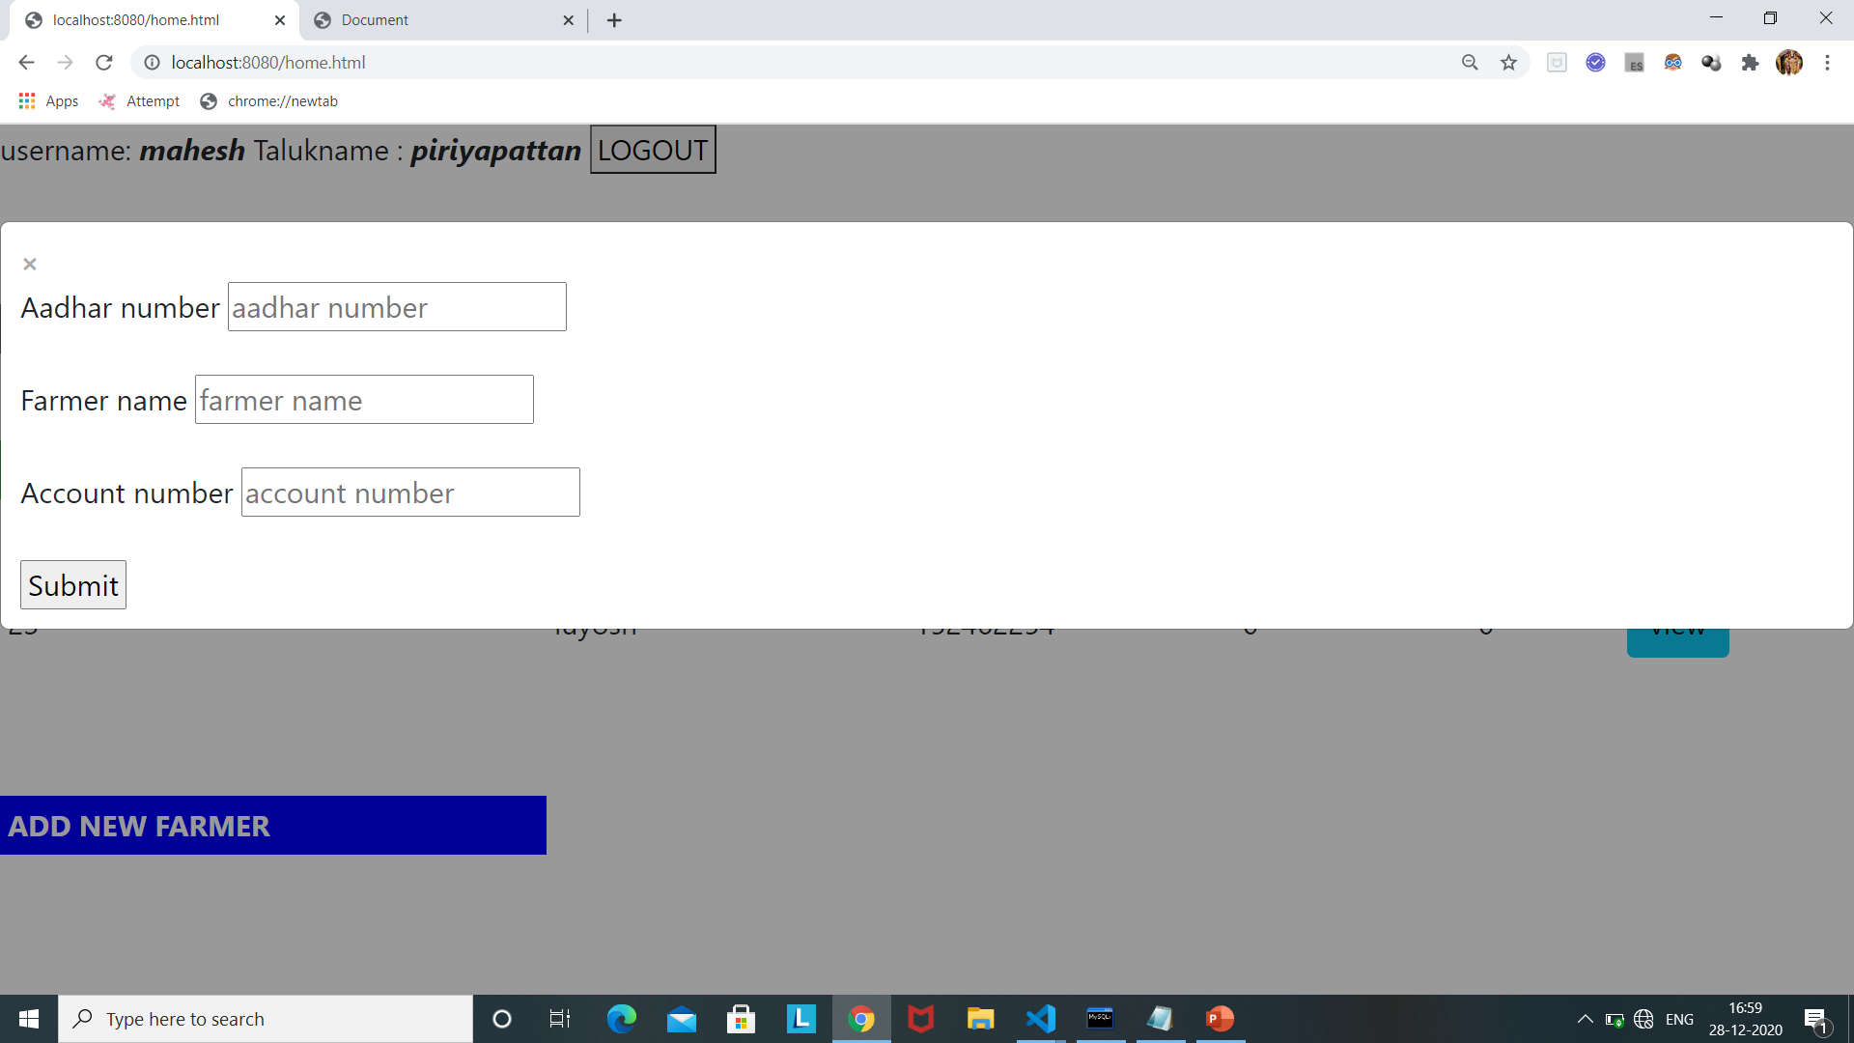
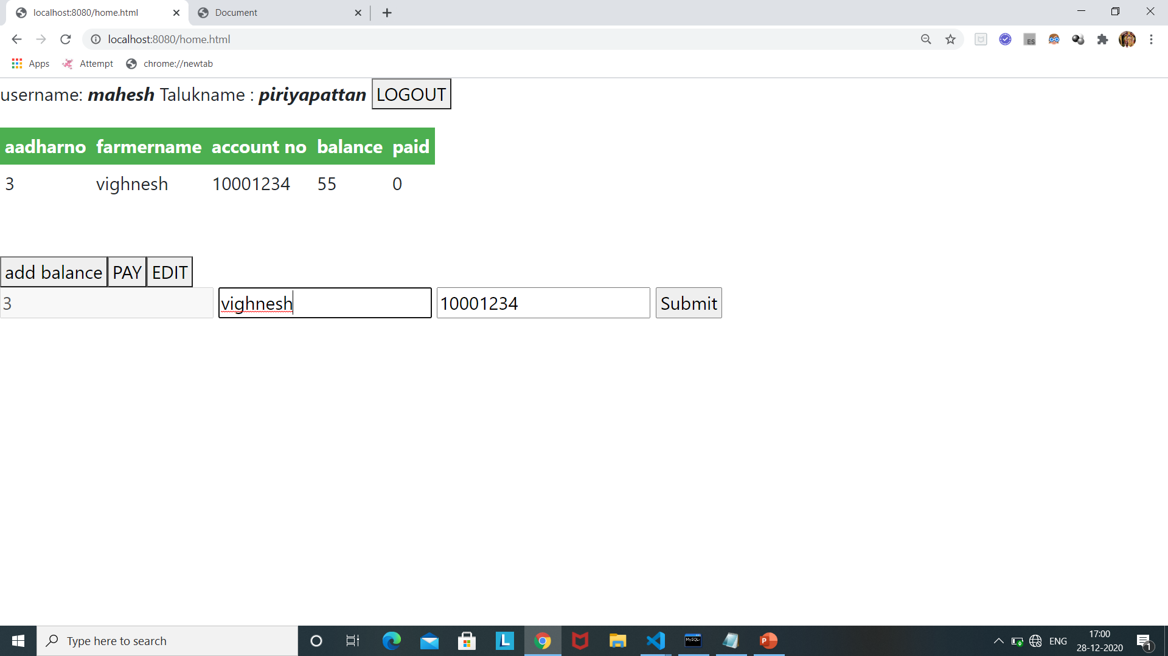
Continued… (ADD NEW FARMER & ADD BALANCE

Slide 21
CONTINUED…
When we click on pay, payment part will open there we enter rupee and click ok then that much money will add to his account.
If we integrate this with payment api then they bank message also.
When we click on add new farmer, Form will open then just we give aadhar number, name and his account number then click on submit,
→New farmer add successfully.
Initially new farmers balance and paid value default zero.

Slide 22
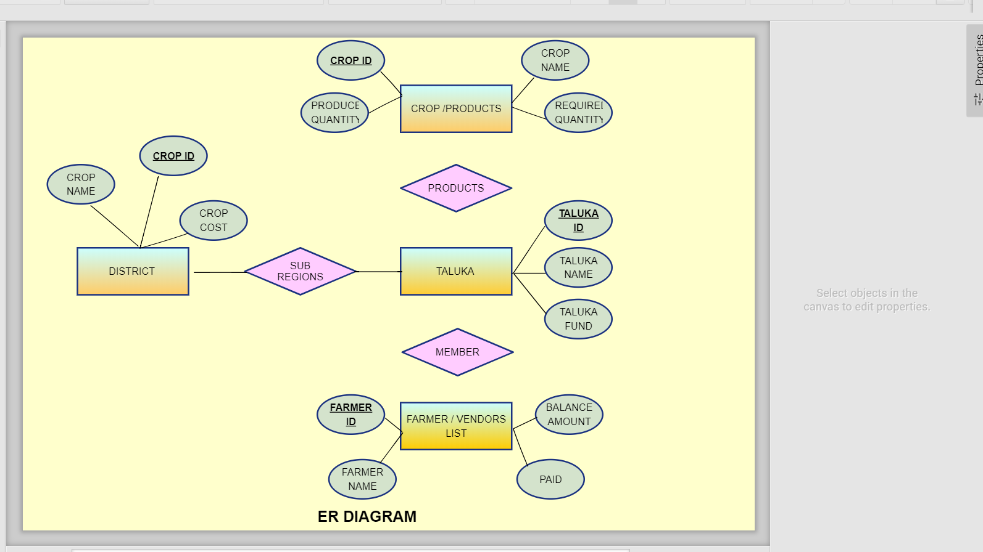
ER Diagram
.
N
1
1
N
1
N

Slide 23
WORK TO BE DONE
Front end Coding part (20%)
Two pages to make style.
Add message api from internet source and it integrate with our code.

Slide 24
.
THANK YOU

